Slide 1
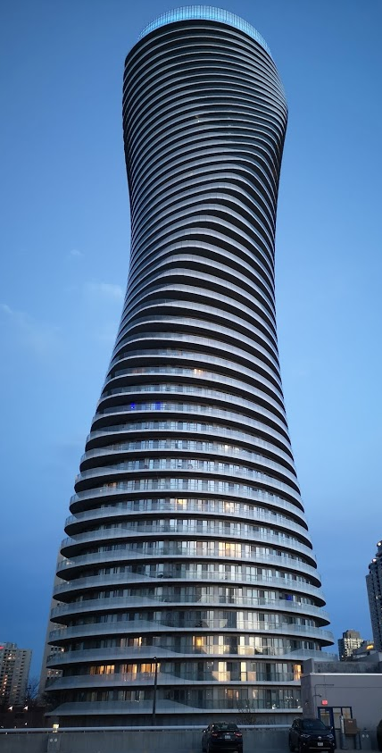
Teranet dataset
EDA results
Prepared by: Stepan Oskin
Notes:
Growth centers
West Don Lands
Liberty village
Riverdale
Outline
Deadline to submit thesis
Month-by-month tuition

Slide 2
Section 1:
Bottom cut-off
for consideration amount

Slide 3
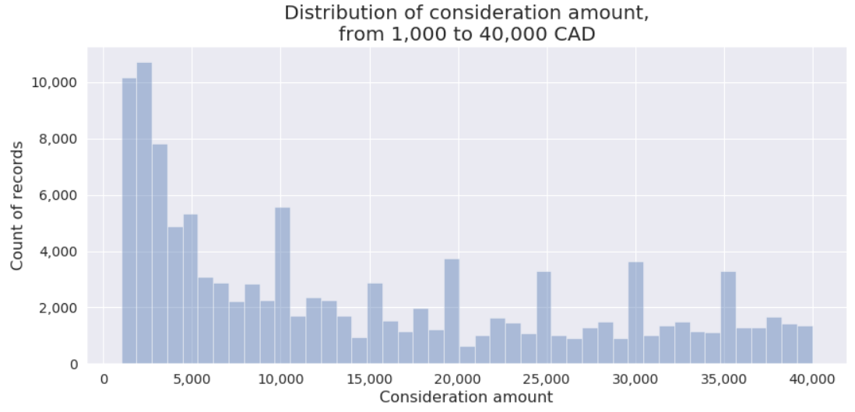
1.1: Distribution of price, proposed cut-off

Slide 4
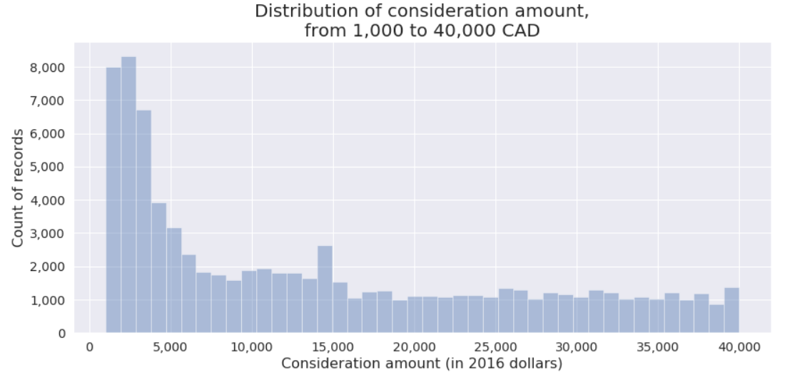
1.2: Proposed cut-off (in 2016 dollars)

Slide 5
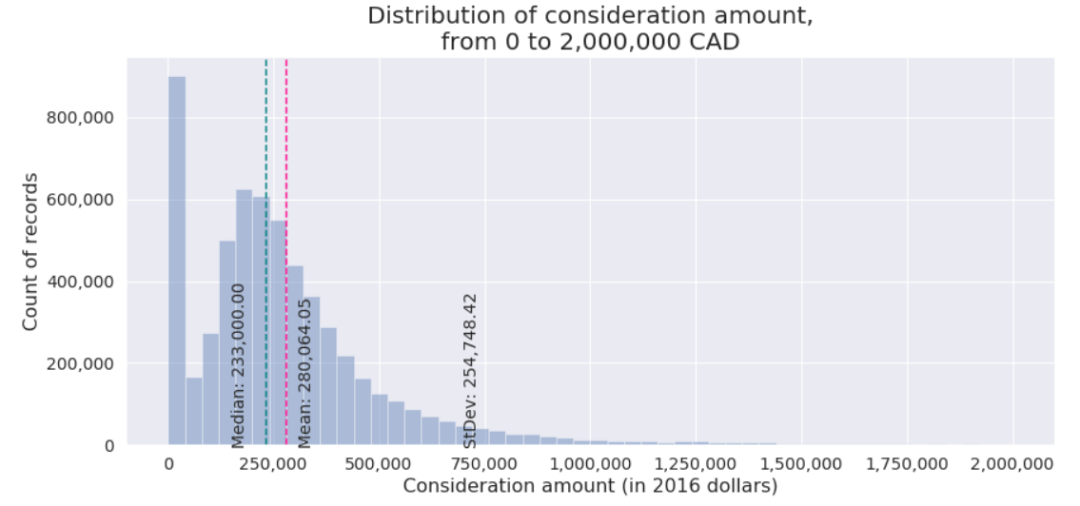
1.2: Distribution of price, unfiltered

Slide 6
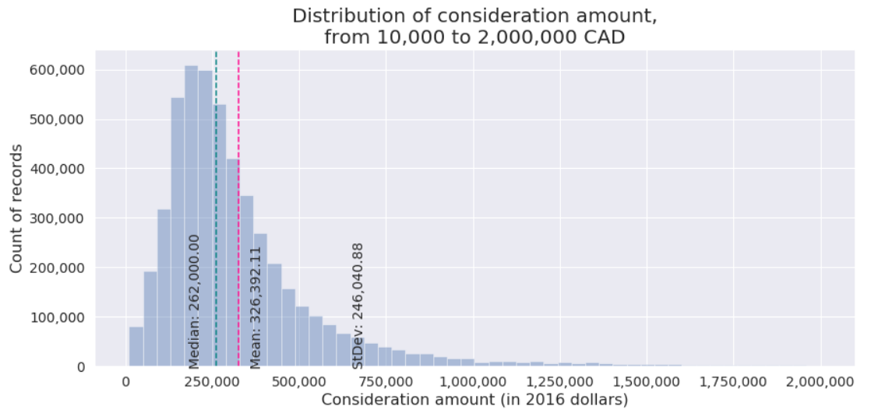
1.3: Distribution of price, filtered

Slide 7
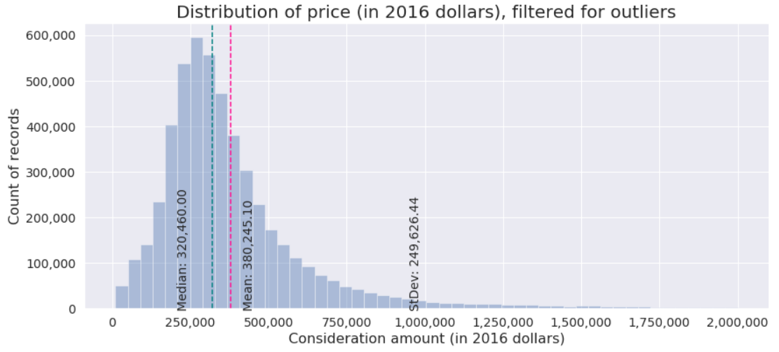
1.1: Distribution of price corrected to 2016

Slide 8
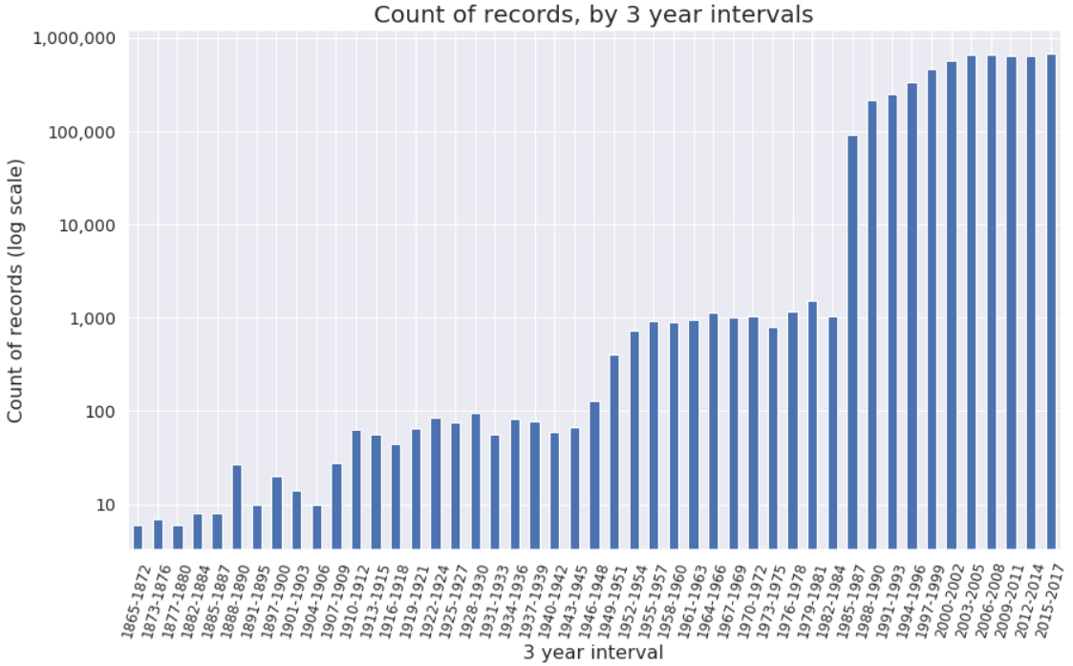
1.2: Count of Teranet records, 3-year intervals
Dramatic change in the count of records from 1984 to 1985

Slide 9
Section 2:
Boxplots

Slide 10
Section 1.1:
Boxplots of price
by year

Slide 11
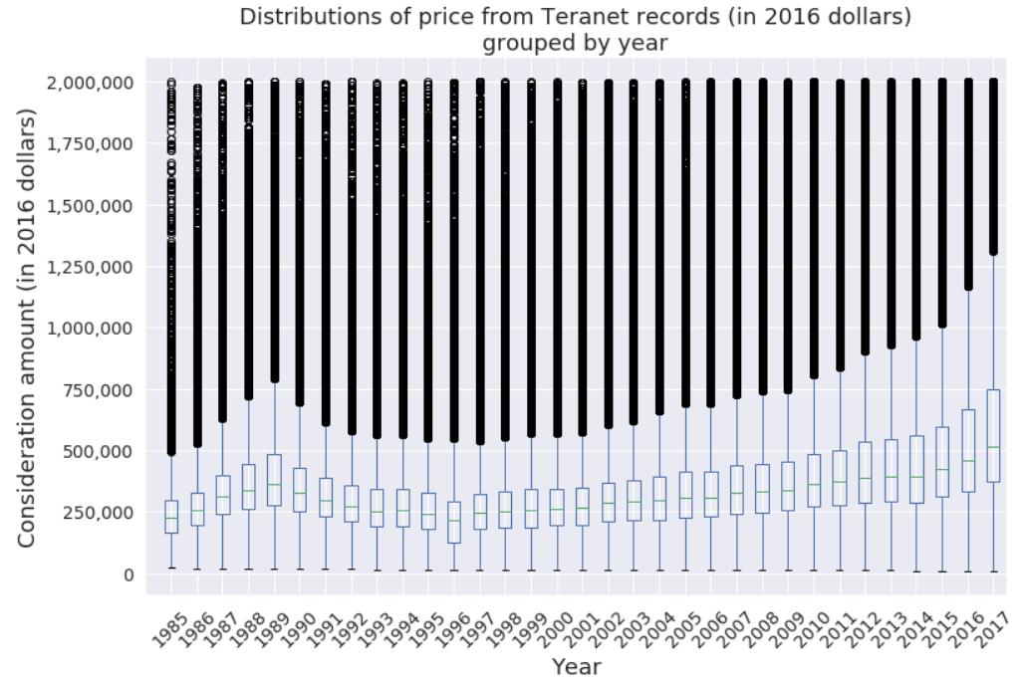

Slide 12
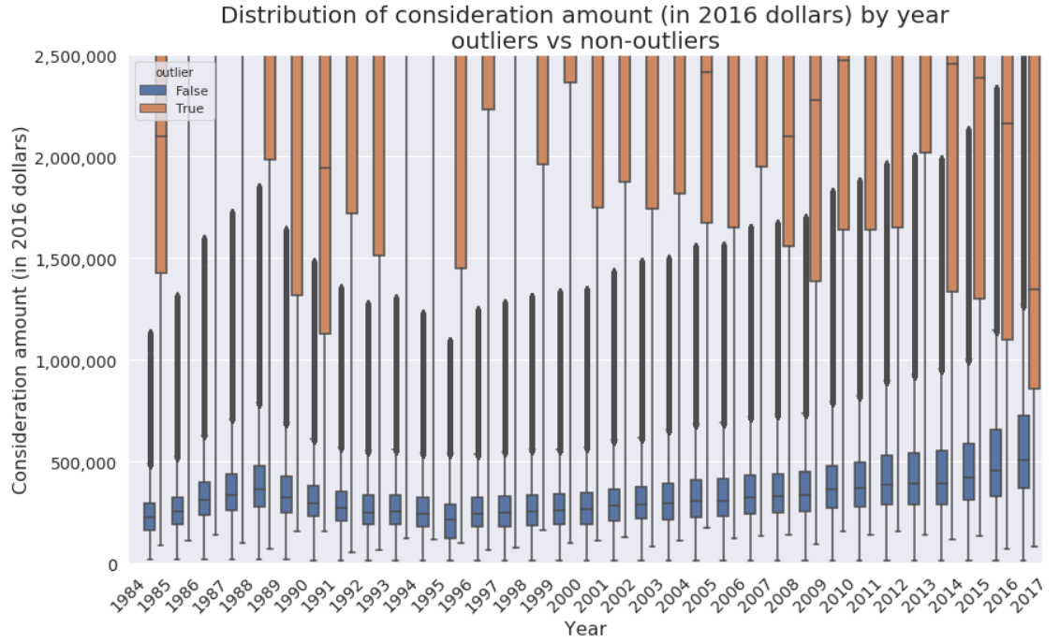

Slide 13
Section 1.2:
Boxplots of price
by municipality

Slide 14
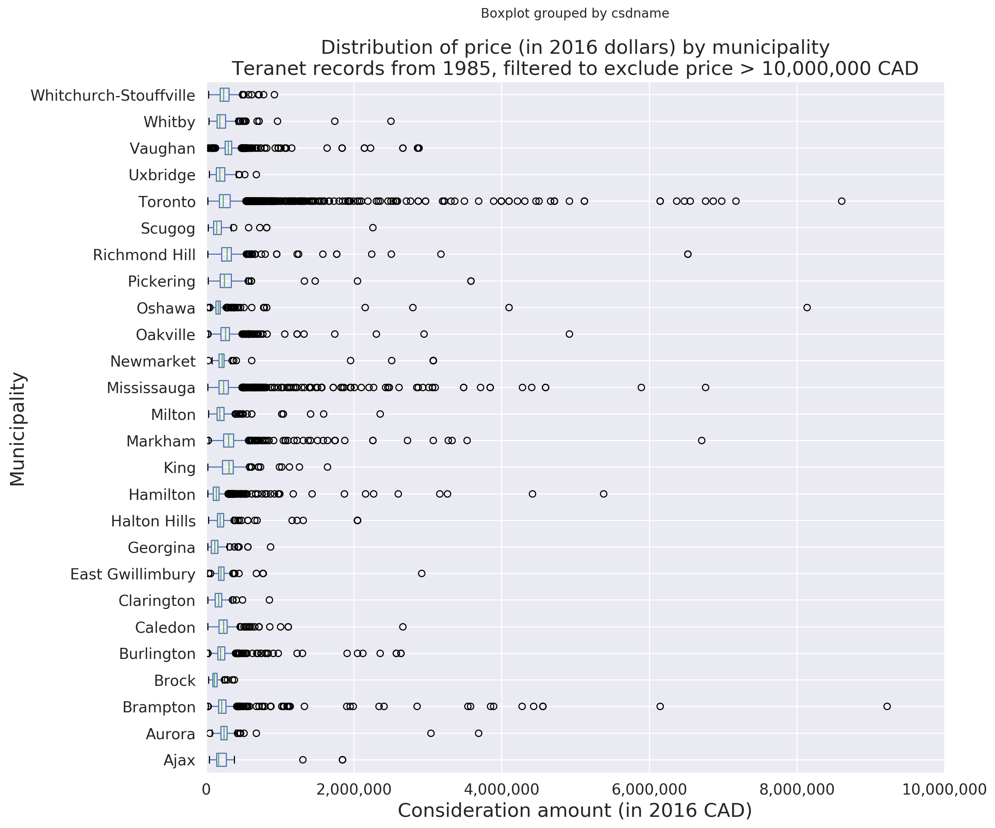

Slide 15
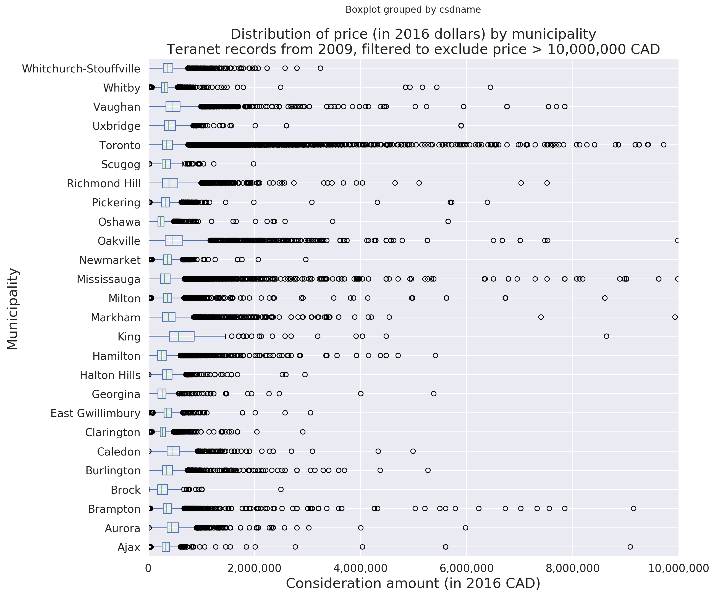

Slide 16
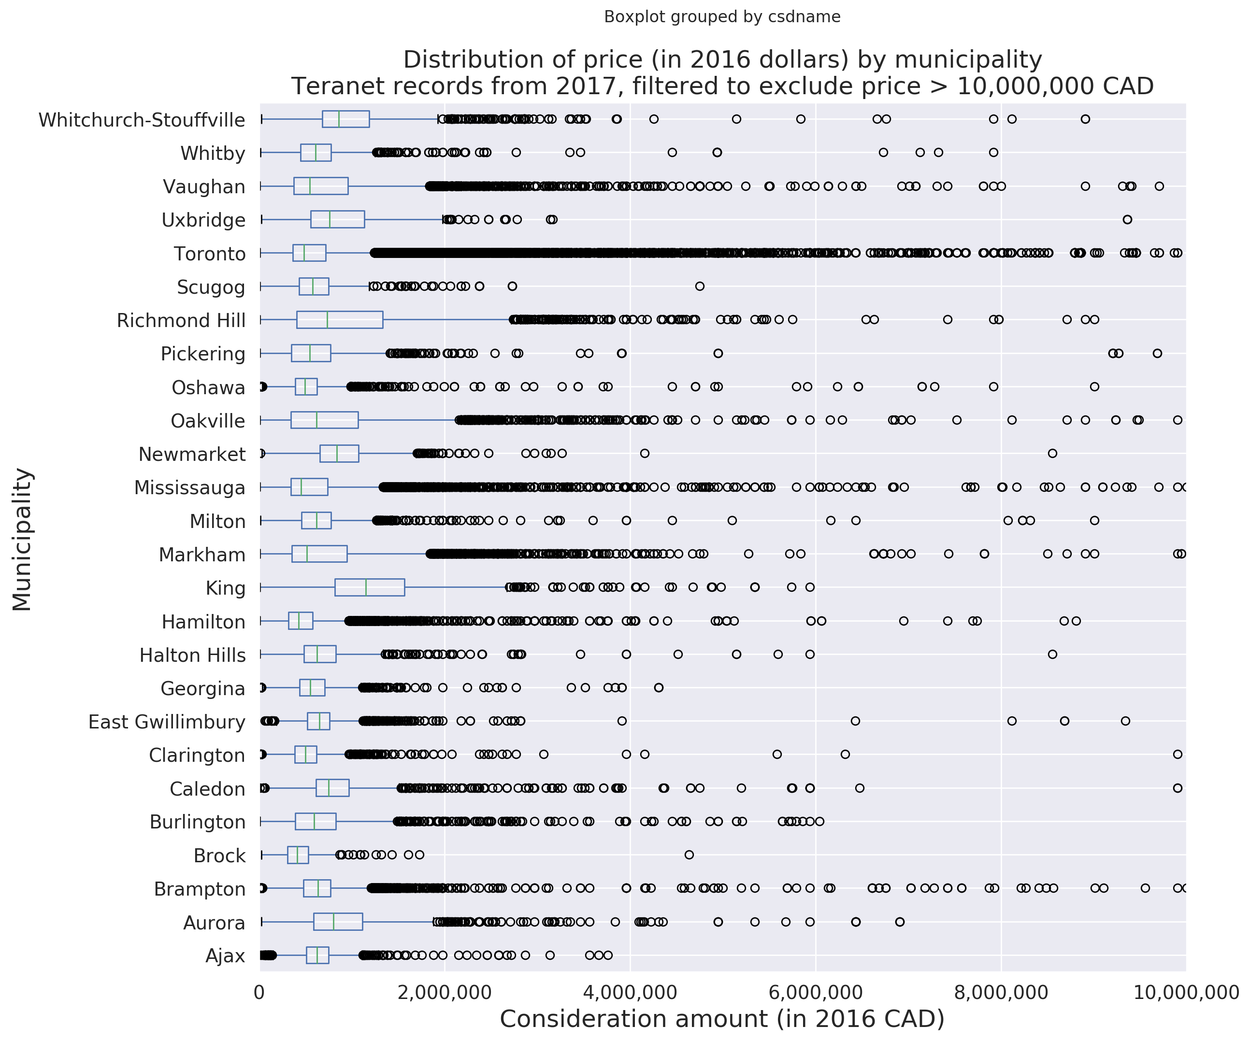

Slide 17
Section 1.3:
Boxplots of price
by detailed land use

Slide 18
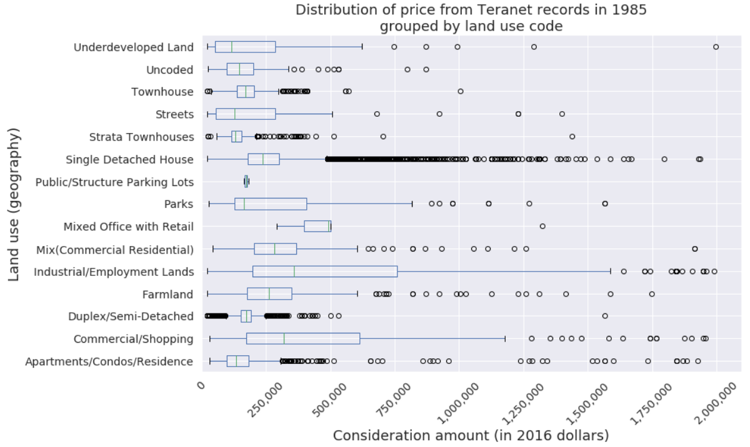

Slide 19
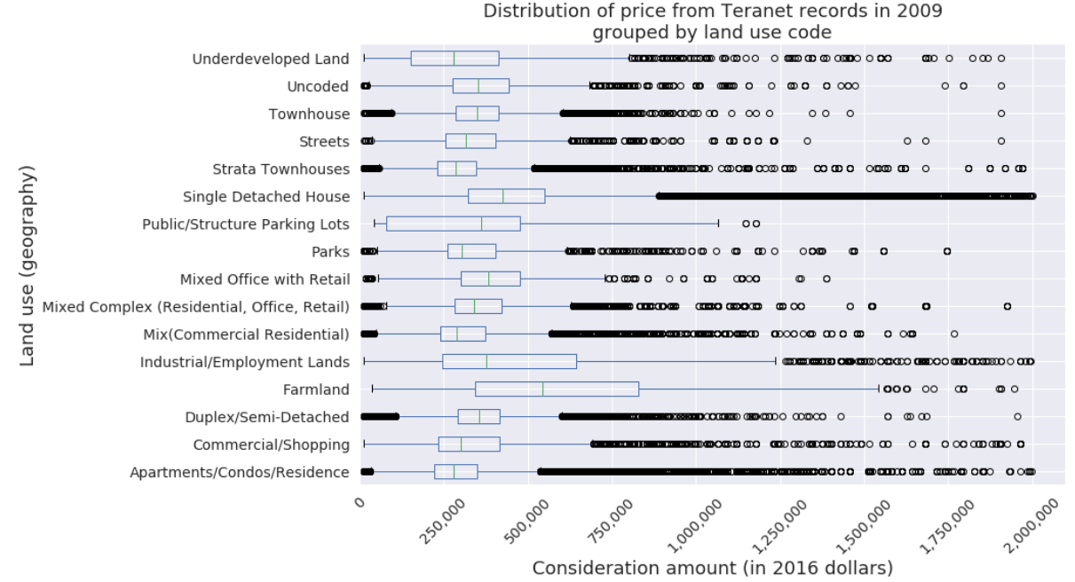

Slide 20
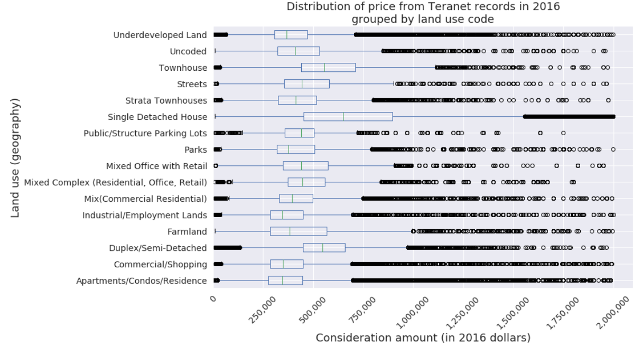

Slide 21
Section 2:
Time series

Slide 22
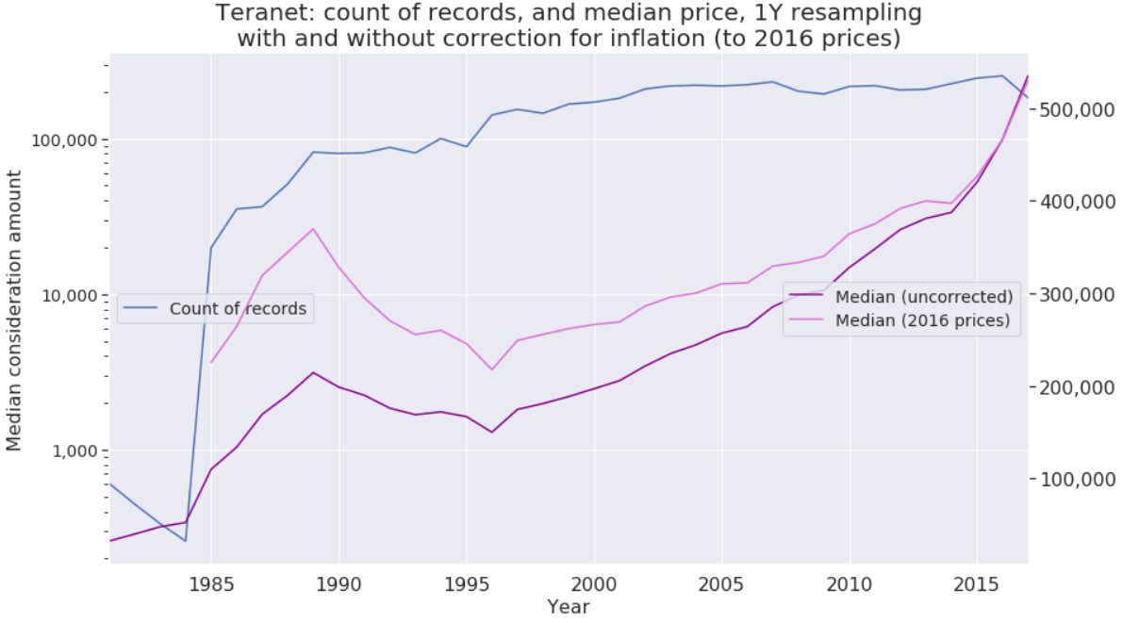
1.3: Median consideration amount
with and without correction for inflation (to 2016 prices)
YEAR | 1985 | 1986 | 1987 | 1988 | 1989 | 1990 | 1991 | 1992 | 1993 | 1994 | 1995 | 1996 | 1997 | 1998 | 1999 | 2000
Percentage change compared to 2016 prices (X) | 104.92 | 97.40 | 88.47 | 81.32 | 72.36 | 65.09 | 55.35 | 53.69 | 51.17 | 51.17 | 47.21 | 45.06 | 42.65 | 41.25 | 38.97 | 35.18
2001 | 2002 | 2003 | 2004 | 2005 | 2006 | 2007 | 2008 | 2009 | 2010 | 2011 | 2012 | 2013 | 2014 | 2015 | 2016 | 2017 | 2018 | 2019
30.80 | 29.23 | 25.95 | 22.84 | 20.77 | 17.90 | 15.37 | 11.87 | 12.16 | 11.10 | 7.76 | 6.17 | 4.96 | 2.54 | 1.49 | 0 | -1.00 | -3.37 | -5.28

Slide 23
Section 2:
Large counts of records
by street name

Slide 24
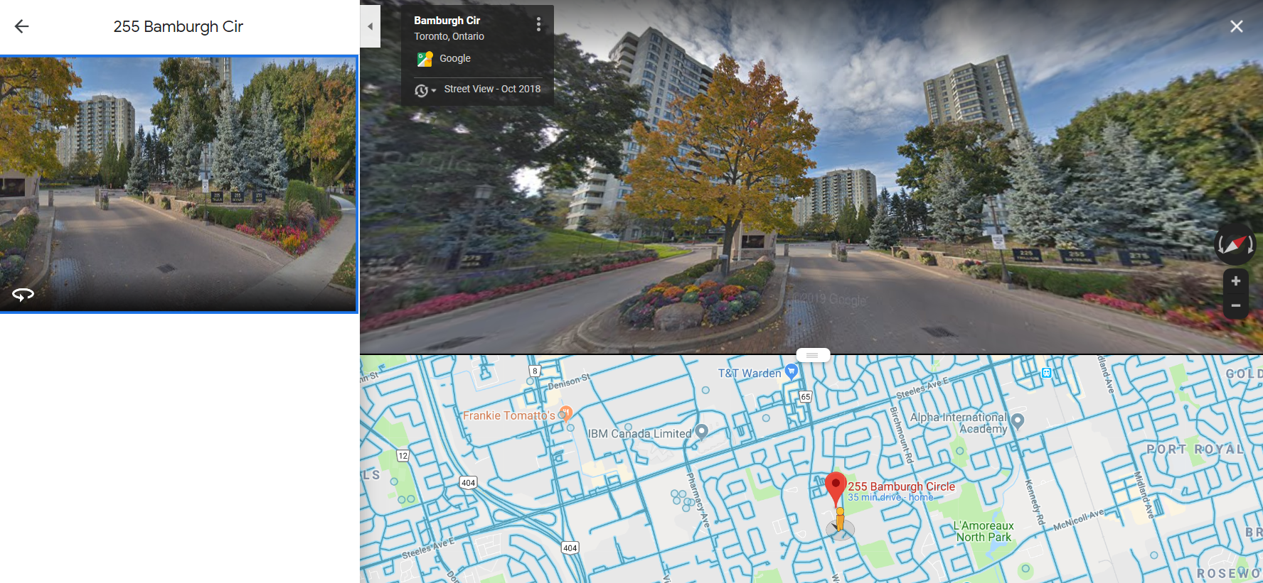
2.1: Bamburgh Cir, Scarborough

Slide 25
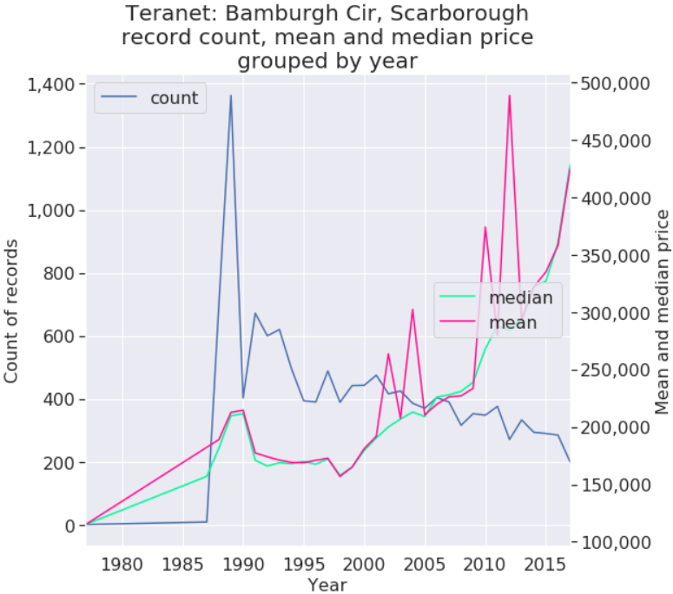
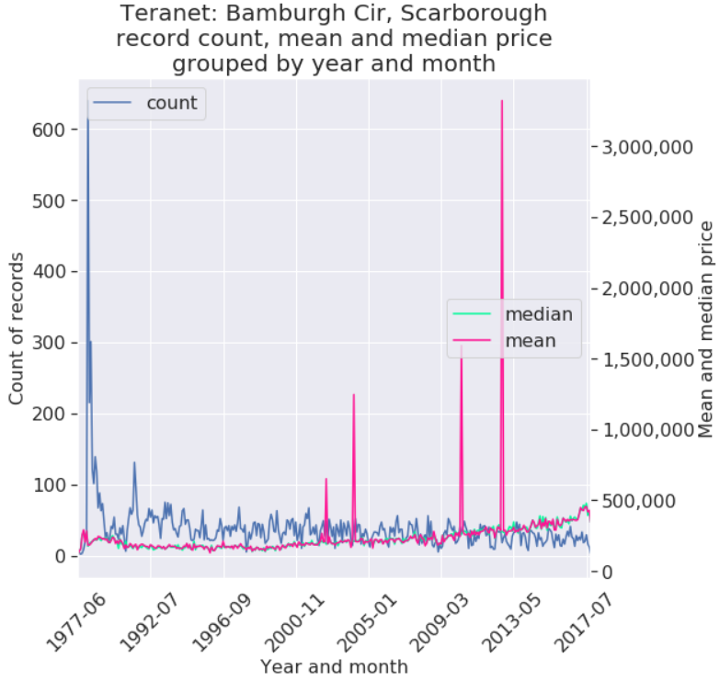
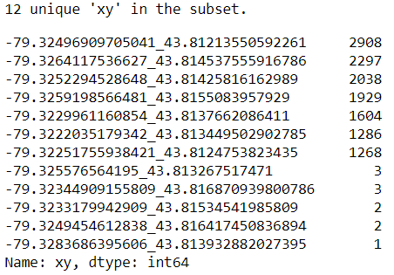
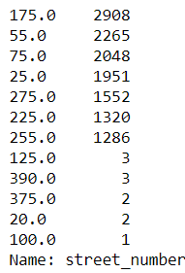
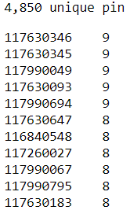
2.1: Bamburgh circle, Scarborough
Teranet record count
By street address:
By xy:
By pin:

Slide 26
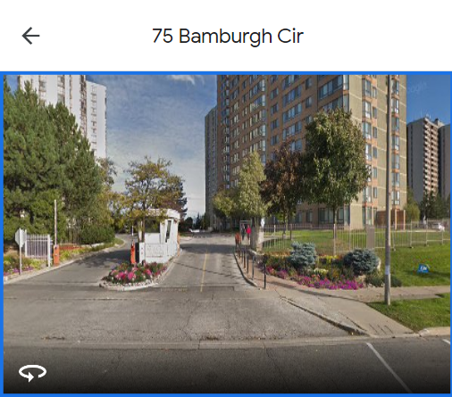
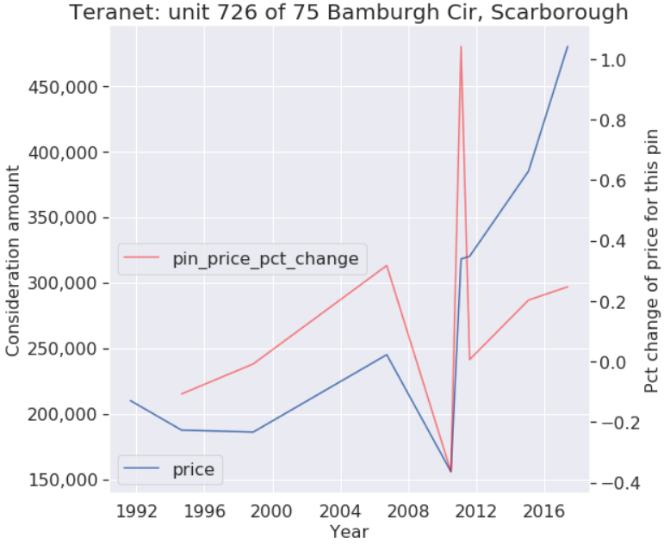
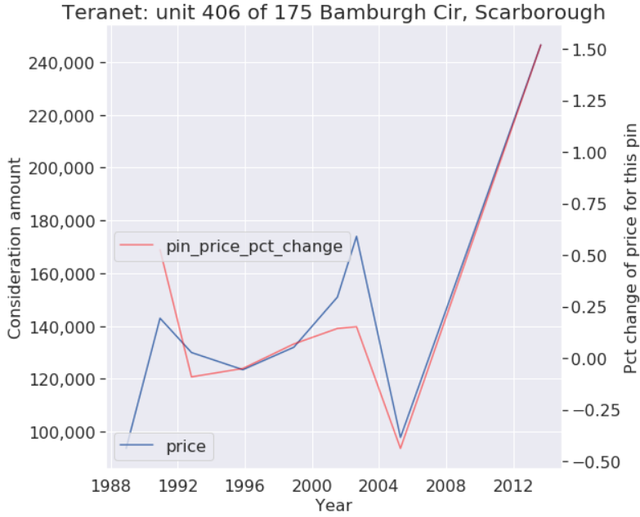
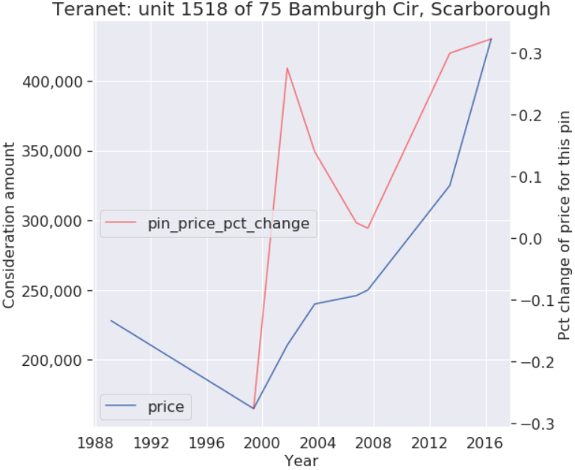
75 Bamburgh Cir, Scarborough individual unit sales

Slide 27
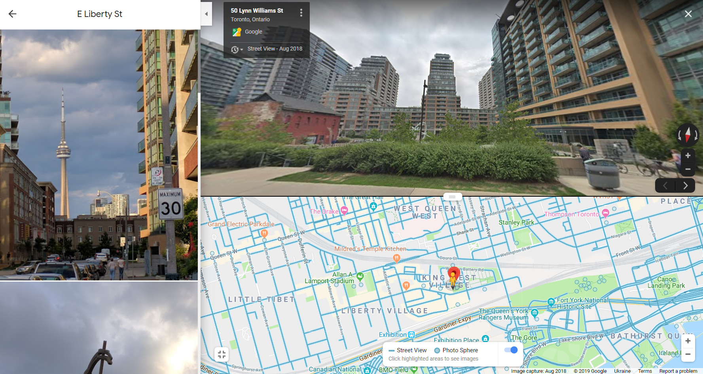
2.2: East Liberty St, Toronto

Slide 28
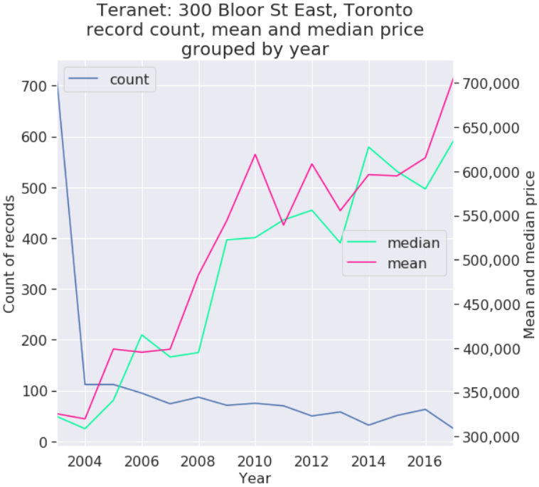
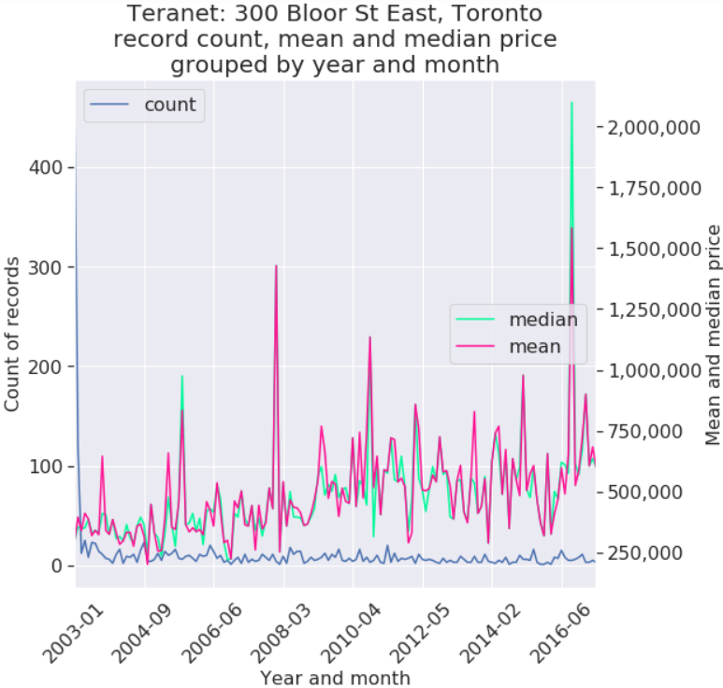
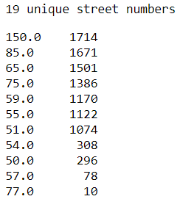
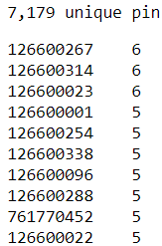
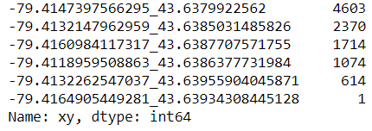
2.2: East Liberty St, Toronto
Teranet record count
By xy:
By street address:
By pin:

Slide 29
Section 3:
Large counts of records
by individual address

Slide 30
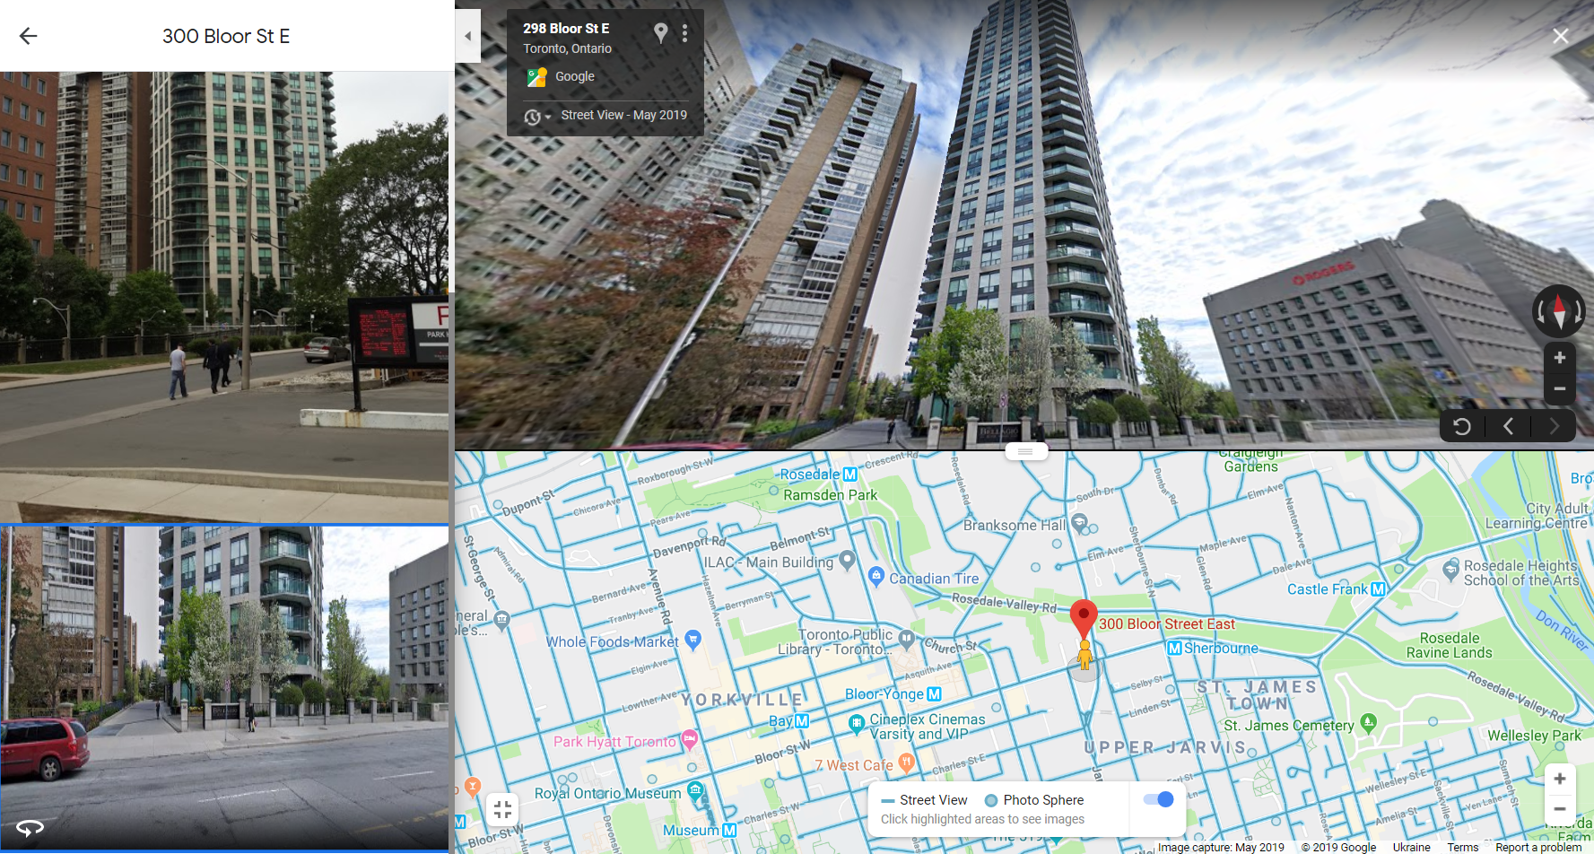
3.1: 300 Bloor St East, Toronto

Slide 31
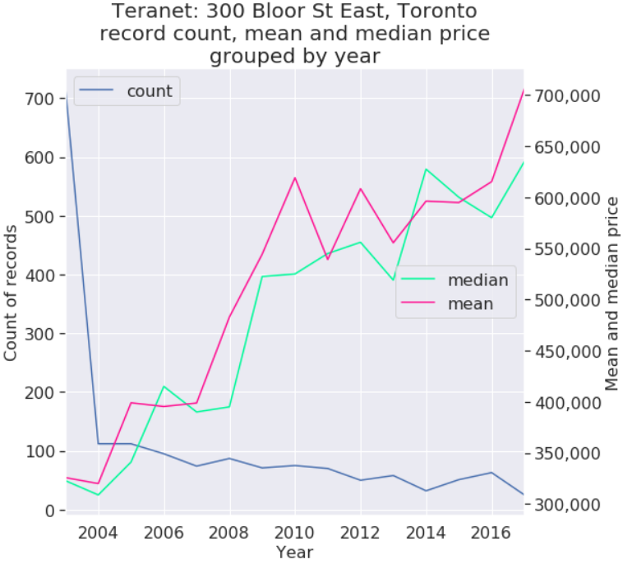
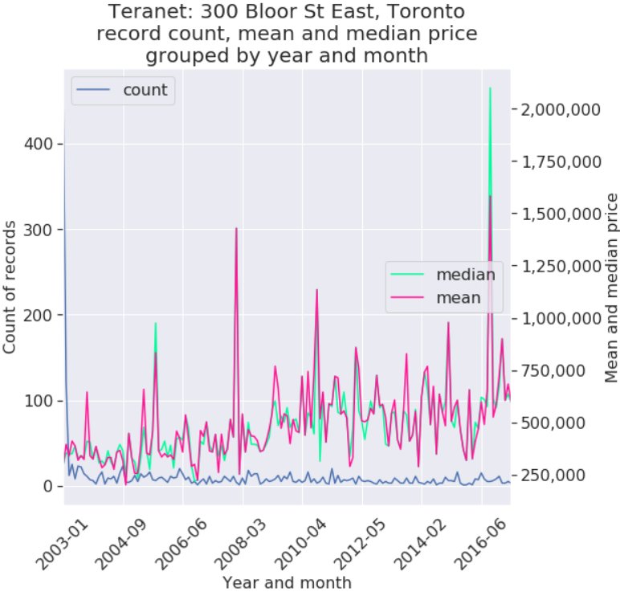
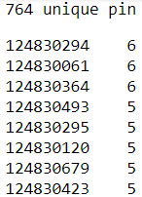
3.1: 300 Bloor St East, Toronto
Teranet record count
By pin:
By street address:
By xy:

Slide 32
Section 4:
Maps

Slide 33
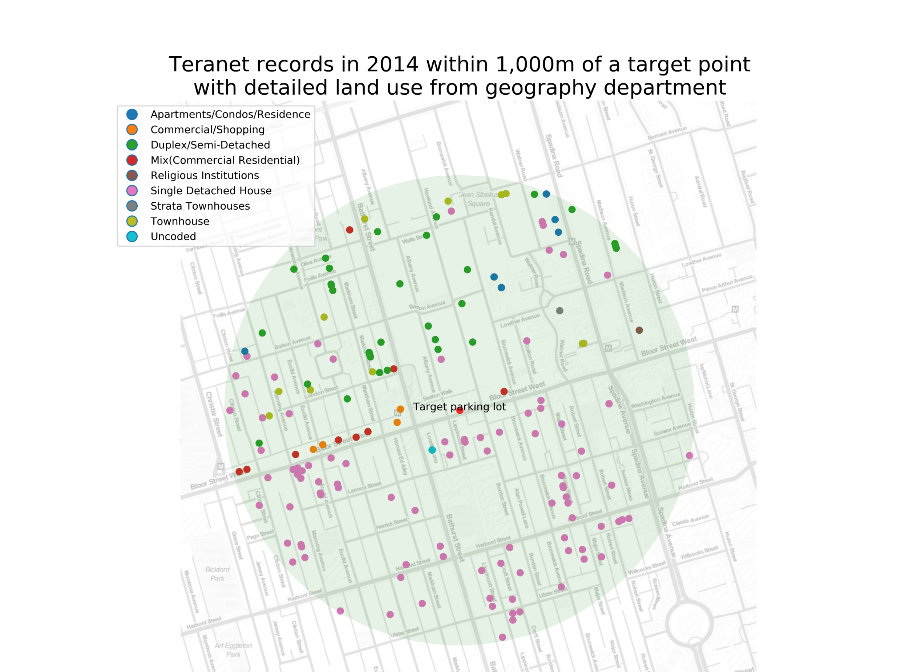
4.1 Teranet records within 1’000m of a point

Slide 34
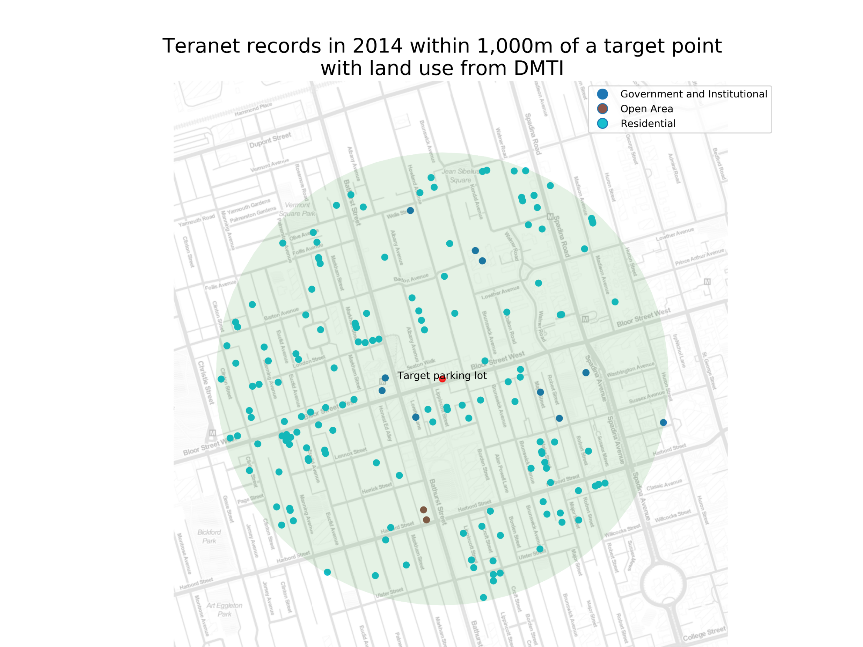
4.1 Teranet records within 1’000m of a point

Slide 35
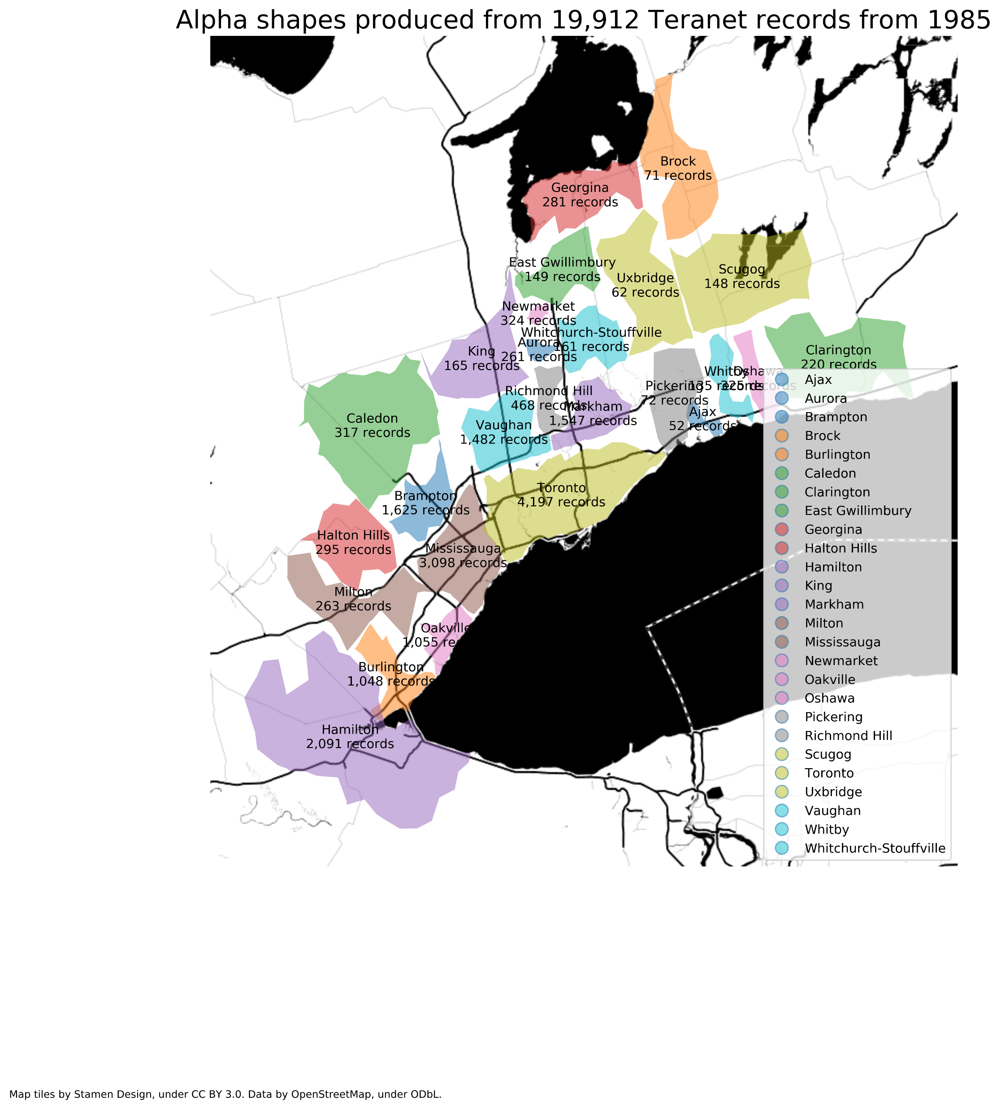
4.2 Alpha shapes of GTHA municipalities produced from Teranet records by year

Slide 36
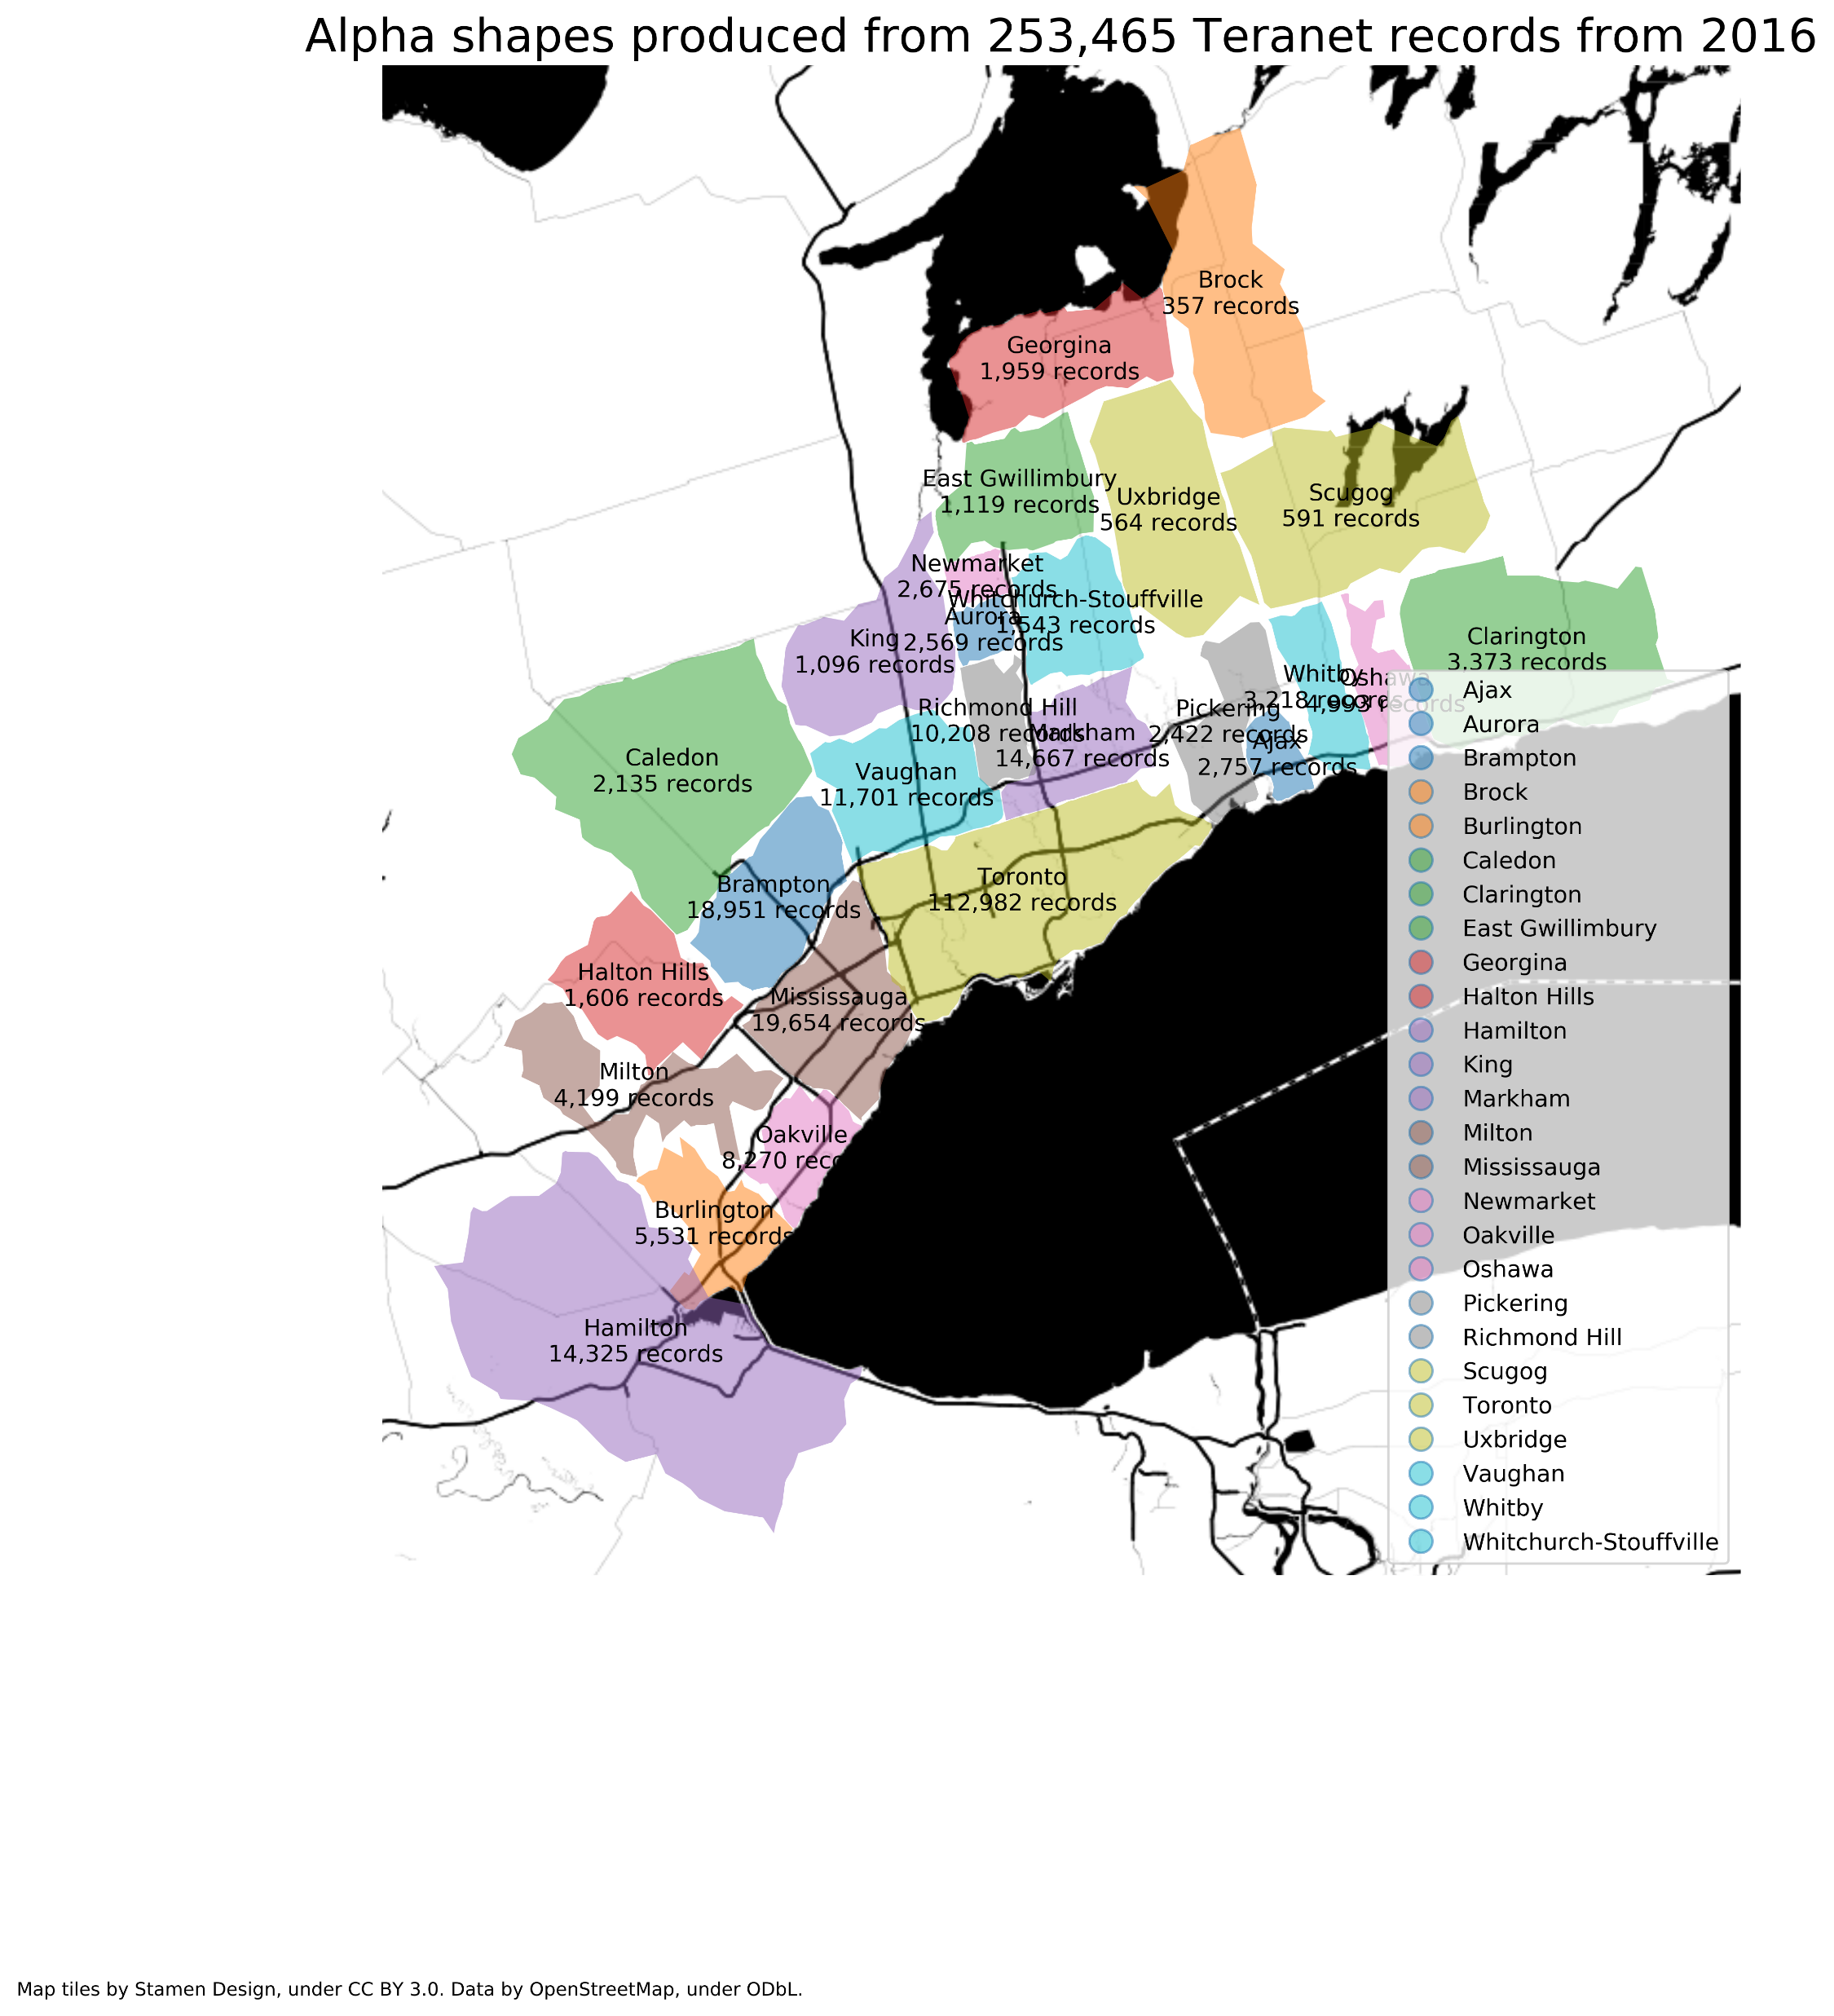
4.2 Alpha shapes of GTHA municipalities produced from Teranet records by year

Slide 37
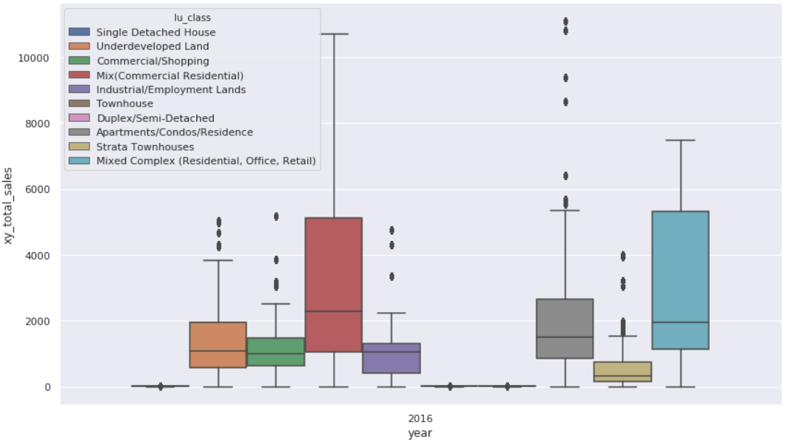
Distribution of count of Teranet records, by land use type (top 10 used)

Slide 38
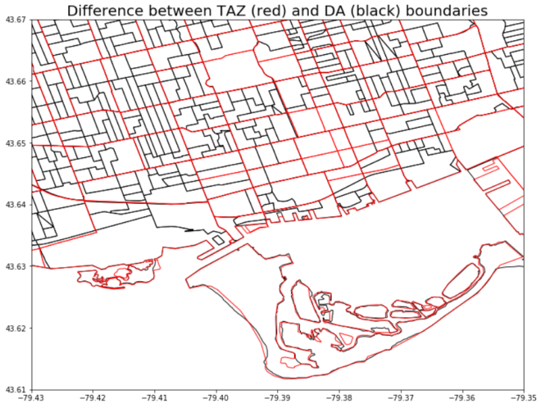
Spatial relationship between data sources

Slide 39
Thesis chapters
Introduction
Background
complexity and “wicked” planning problems
land use and transportation
Land registration in Ontario
Challenges of working with Teranet data
Data sources, spatial, and temporal relationships
Data preparation
Database design
EDA
Conclusion

